Slide 1
Cold War

Slide 2
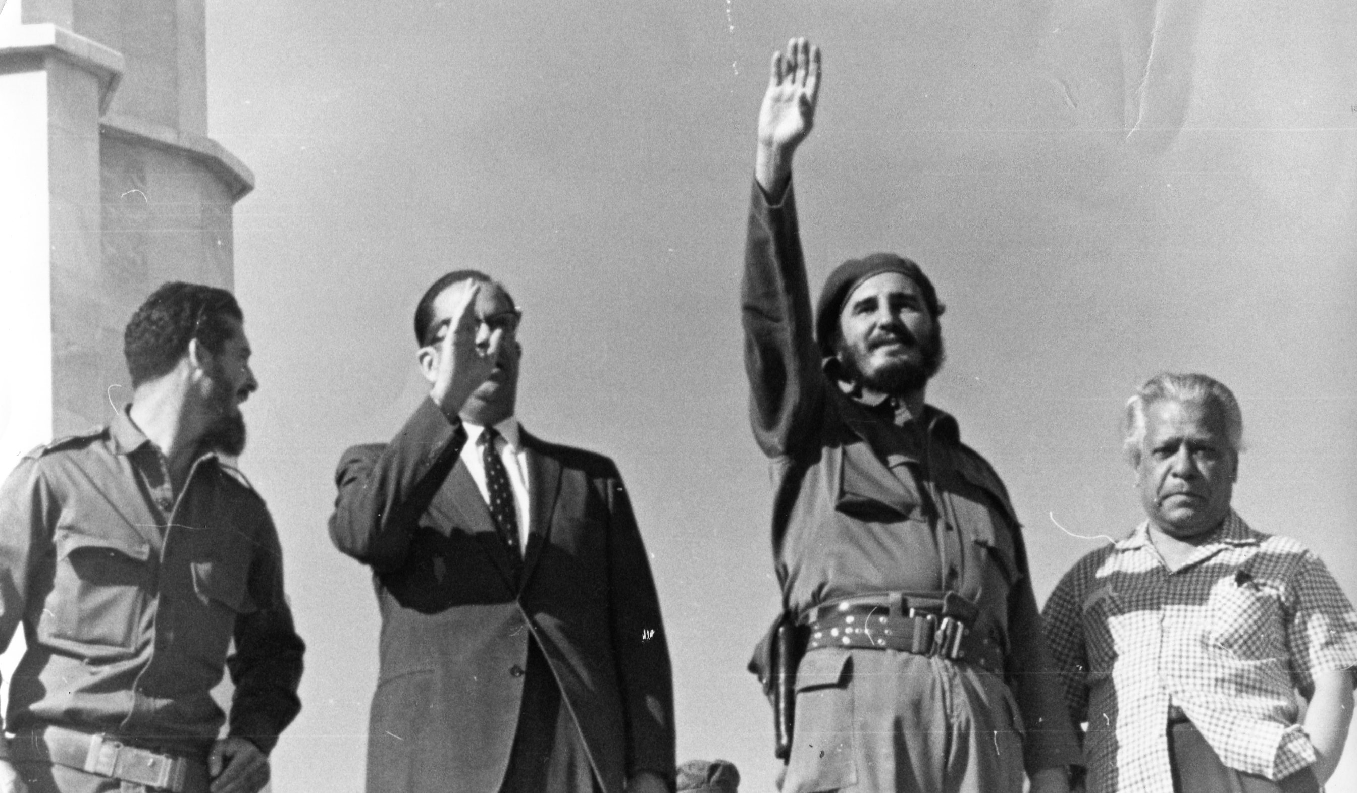
Cuban Revolution
July 26, 1953 – January 1, 1959
Causes:
Economy dependent on Sugar = unemployment and inequalities
Resentment towards U.S. control/effect on Cuban economy and politics
Political Instability
Batista’s Regime = no reforms / repression
Rise of Fidel Castro = attack on Mocada army barracks, 26th of July Movement, Defeat of Batista’s forces, appeal to Castro’s movements
Summary
The Cuban Revolution was led by Fidel Castro and the 26th of July Movement to overthrow current dictator Fulgencio Batista. It began with the assault on the Moncada Barracks on July 26, 1953, and ended on January 1, 1959, when Batista was driven from the country and the cities Santa Clara and Santiago de Cuba were seized by rebels, led by Che Guevara and Fidel Castro's surrogates Raul Castro and Huber Matos.
Outcomes
Castro took full control of gov.
Took away freedom of press
Nationalized private property and businesses
Limited size of landholdings
Led Cuba toward Communism and confrontation with U.S.

Slide 3
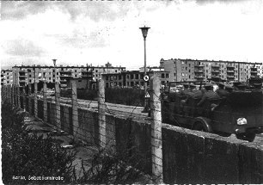
Building of Wall: East Germans were fleeing to West Berlin due to a gap in the Iron Curtain. This caused economic strain and increased tensions between East and West Germany. The executive committee of the USSR and a Soviet leader, Nikita Khrushchev came up with the idea of the Berlin Wall and Walter Ulbricht ordered it to be built.
Fall of Wall: Mikhail Gorbachev took control of the Soviet Union in 1985. He gave the people more power → Sinatra Doctrine → Eastern Bloc Gov’t got more freedom → opened Hungarian border → Protests in East Germany → Freedom of East Germans to pass through wall.
Building of Berlin Wall
Built August 13, 1961
Fell November 9, 1989
Outcomes of Wall: Death Strip where 160 people died trying to pass wall. Families were separated, people who worked on both sides of wall lost their jobs. Germany was reunified.
It was not a Proxy war.
The Berlin wall in 1989 led to the alliance of the Warsaw pact officially ending in 1991.
The building of the Berlin Wall was a win for communism, but once it was torn down, it aided in the end of communism, which was a victory for capitalism.

Slide 4
Overthrow of Allende government
By: Camila Zapater
Causes: Inflation and unemployment that arose with the fall of the copper industry in Chile are two of the major causes that forced the people of Chile to strike against the government.
11 September 1973
The United States played a major role in the overthrow of the Allende government by sponsoring antil-Allende propaganda in Chile’s media and supporting anti-Allende politicians in order to help protect their own industry and power.
The outcome for the civilians in Chile was devastating, thousands were killed, injured, or missing in the aftermath of the coup. Many of the Chilean citizens had to be relocated to other countries like Canada, where there were over 38,000 refugees. The political outcome by Junta was a dissolved congress and outlawed parties that had been a part of the Popular Unity Coalition. Long term effects was the establishment of a democracy a few years later after the overthrow of the Allende government.
The overthrow of the Allende Government was not a proxy war because even though the United States played a part in progressing the overthrow of the Allende government, it was only a sudden and violent seizure of the government otherwise known as a coup.
The victory went to capitalism because of the intervention of the United States in the election.
Neither the Warsaw pact or NATO was involved with the overthrow of the Allende Government.

Slide 5
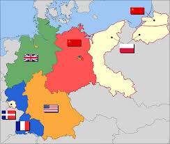
Postwar Division of Germany June 5, 1945 - 1949
Causes: Victory for Allies in WW2 (need to end Nazism and recieve war compensation). Political differences between Russia and other occupying countries
June 5, 1945: Allies declared plan to govern Germany through 4 ocupation zones (for Brittian, France, Russia, and the U.S.) with Berlin occupied by all 4 powers. Decision reached through confrence in Casablanca (1943), the Tehran Confrence (1943), and the Yalta Confrence (1945).
Potsdam Confrence (summer 1945): revealed tension between the U.S., Britain, and the Soviet Union; Stalin granted most of his requests including Polish authority in parts of Germany in compensation for lost territory
Allied Control Concil (ACC): Allies’ four supreme commanders; unanimous decsion seldom reached so policies varied
France: extract as much compensation as possible
Soviet Union: extract and establish socialist state
United States: denazify and establish democratic policies
Britain: increase economic independence or tax payers suffer
Bizone: created when U.S. and Britain joined economically
1949: Allies approve constitution for West Germany (Fedral Republic of Germany) and a communist based one for East Germany (German Democratic Republic)
Outcome:
A democratic West Gemany and communist East Germany.

Slide 7
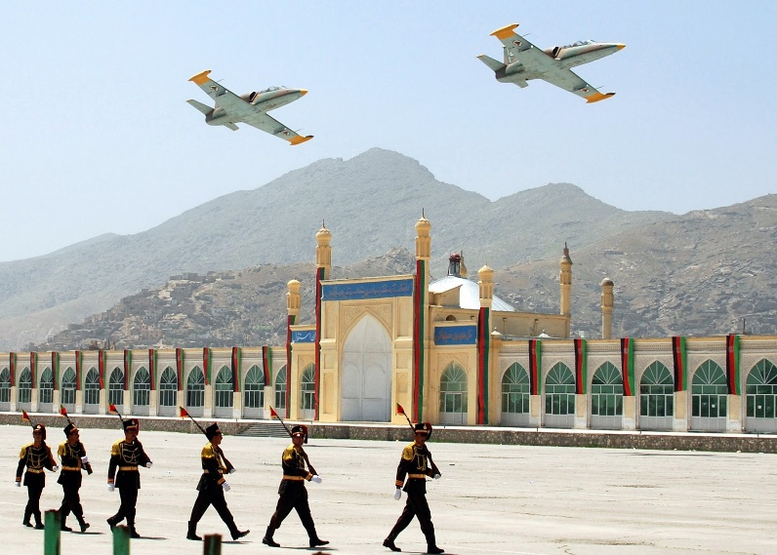
Soviet Invasion of Afghanistan
1979-1989
Proxy War between Russia & US
NATO & Warsaw Pact not involved
It was a loss for Communism but not a major gain for Capitalism
Causes: Communist expansion, Red Scare, Problems with Pakistan, Soviet treaty, rebel militants
Key Players: Soviet Russia + Troops, Mujahideen rebels, and US advisors
Soviet Russia supplied troops to Afghanistan to fight rebels, but they weren’t used effectively so the soviets deposed President Amin and installed their own puppet. A full on war broke out between the soviets and the rebels. The rebels finally won after the US supplied weapons and training.
Effects: Afghanistan was left in ruins and made it easy for the Taliban to seize control and create a safe haven for Osama Bin Laden
15th Anniversary of Rebel Win

Slide 8
The Marshall Plan (1948-1951)
Causes: With the rising tensions between the newfound superpowers from WW2, the United States felt increasingly pressured by the communist presence that closed in on eastern Europe. As a response of sorts, America secured western Europe from the onslaught of Soviet pressure with the Marshall Plan.
Summary: Also known officially as the European recovery program, the notion was proposed by the secretary of state, George Marshall. Within the time span of three years, the U.S. fostered the fawn leg economies of the post-war western Europe by providing nearly $13 billion in aid towards 16 target nations (including Germany) to cater to each nation’s administrative and technical needs in rebuilding economic pillars.
Outcomes: With the influence of American aid, European recovery from WW2 hastened beyond projected rates, as well as securing an alliance between the western world that would later come to fruition as the North Atlantic Treaty Organization. In addition, the industrial build up and economic success from the Marshall Plan provided a basis for the European Union. Given this outcome, it can be seen as a social and economic victory for Capitalism.

Slide 9
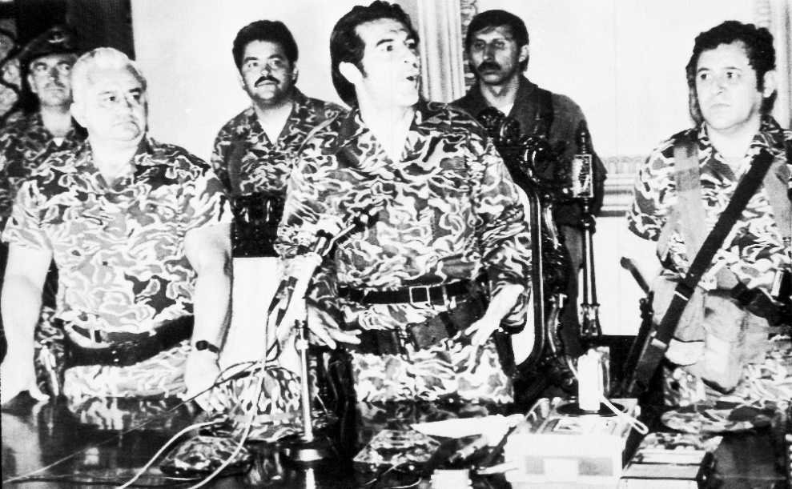
Overthrow of Guatemalan Government
1952-1954
Causes: Land reforms implemented by the president caused the U.S. to label the country as communist.
Summary: In 1952, the U.S. began sending weapons to anti-president militias. When this was discovered it ceased until 1953. In 1953, the CIA created operation PBSUCCESS, a covert operation approved by Eisenhower. There was however, a catch. The CIA couldn’t use American troops to do the mission. So the CIA set up training camps in the neighboring countries and trained a small amount of volunteers and ran a massive propaganda campaign to cover up the small numbers of their force. After almost a year, the newly trained army attacked and easily overthrew the government. However, the CIA later exaggerated its effectiveness, claiming only one death as compared to the 48 men that actually died.
Outcomes:
Clear message to stay out of the west to soviets.
Newfound reliance on covert operations due to exaggerated success.
U.S. favoring government in Guatemala.

Slide 10
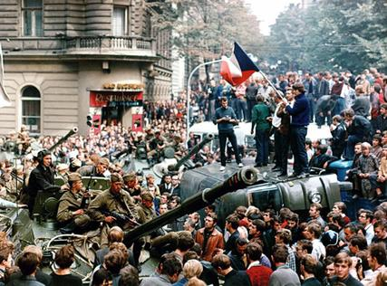
Czechoslovakia Uprising 1968
Causes: Alexander Dubchek, 1st Secretary of Communist Party, came to power and
launched reforms in efforts to liberate the Czech peoples.
Summary: Reformist movement under Dubcheck called the “Action Program” that
increased freedom of press, speech, movement, and also placed emphasis on
consumer goods and option of multi party government. These reforms were not
accepted by Soviet Union, and they were quick to reverse them.
Outcomes: Contributed to ideals that suggested distanced from Soviet Union
dominance, troops occupied Czech until 1990.
-The Warsaw Pact did intervene to settle the
uprising and “normalize” the Czech people
again and included removing reform laws and
reinstating power of the police.
-Not an example of a proxy war.
-This was a victory for communism,
because although it sparked a flame
through the people, the communists
gained control again and reversed all
of the reforms.

Slide 11
Building of Wall: East Germans were fleeing to capitalist West Berlin due the harsh communist life. This caused economic strain and increased tensions between East and West Germany. East German workers guarded by troops built the wall. East Germany was so low on food and natural resources that Lucius D. Clay airlifted supplies to them.
Fall of Wall: Mikhail Gorbachev took control and reduced subsidies and the Soviet Army’s power. With more power to the people, they called a press conference. There, Gunther Schabowski wrongly stated that travel restrictions were lifted. The confused guards let everyone through.
It was not a Proxy war.
The Berlin wall in 1989 led to the alliance of the Warsaw pact officially ending in 1991.
The building of the Berlin Wall was a win for communism, but once it was torn down, it aided in the end of communism, which was a victory for capitalism.
Building of Berlin Wall
Outcomes of Wall: 250 people died trying to cross over. Families were separated, people who worked on both sides of wall lost their jobs. Germany was reunified. The wall became the Cold War’s symbol. End of wall caused end of Cold War.
Built August 12, 1961
Fell November 9, 1989

Slide 12
Berlin Blockade/Airlift
April 1, 1948 – May 12, 1949
Causes:
Following WWII, the US adopted the Marshall Plan
Goal was to support economic recovery in Western Europe and expand American influence into Europe
Western Powers replaced the inflated wartime currency with a new one (the Deutschmark) in West Berlin
Outcomes:
The Soviets finally lifted
the blockade - Capitalist victory
Two weeks later: Britain, US,
France, and 9 other countries established NATO.
West and East Germany established. Definite
border between West’s democracy and
East’s communism.
Following WWII, West Germany
was controlled by the France, Britain,
and the US. East Germany was
controlled by the USSR. Berlin was
located in East Germany, but West
Berlin was in French/British/US
territory, and East Berlin was
USSR territory.
Summary:
Stalin blockades West Berlin to counteract the US
Roads shut down, electricity and gas cut off, less food
In response, the US and Britain start airlift
Over 5,000 tons of supplies dropped over Berlin every day
200,000 flights in a year: a plane would drop supplies every 45 seconds

Slide 13
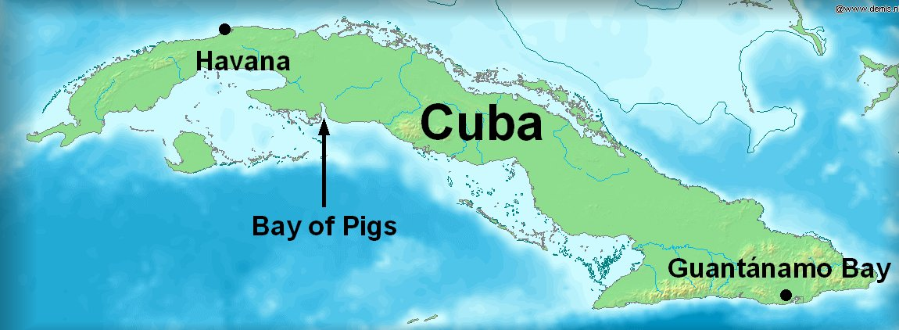
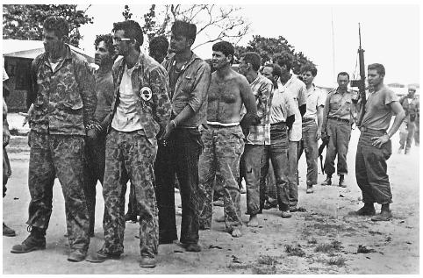
Bay of Pigs Invasion
In March 1960, President Dwight D. Eisenhower ordered the CIA operation to train and arm a group of Cuban exiles for an attack on Cuba. This invasion contained a great desire to overthrow Fidel Castro. His decisions on destroying the U.S. companies and interests in Cuba, being anti-American, and also Cuba’s movement towards a closer relationship with the Soviet Union made U.S. officials think that Cuba was a threat to them. This is why the invasion was continued by John F. Kennedy on April 17, 1961, around 1200 exiles, armed attacked the ashore at the Bay of Pigs in Cuba.
-Outcomes: This was a total failure. Many Cuban exiles were either killed or taken prisoner. Castro in Cuba requested more Soviet military aid which later developed the construction of missiles, which became a great threat to both the U.S. and the Soviet Union. Also, John F. Kennedy’s sabotage campaign, Operation Mongoose, never succeeded.
-Proxy war? It was an example of a proxy war because a war was instigated by the U.S. and the Soviet Union.
-Nato/Warsaw Pact? Nato was not involved and the Warsaw Pact was involved.
-Victory for whom?Communism because Castro first overthrew the capitalist government of Batista, an ally of the U.S. Also by being successful in the Bay of Pigs Invasion, communism got stronger.
17-19 April 1961

Slide 14
Solidarity Movement Poland
Established in September 17, 1980
Causes: The Poland was facing with governmental and economic difficulties, Because of Polands shortage economy, people were unable to buy necessities. Along with the government raising the price of goods and restraining the growth of wages.
The Solidarity movement started out by the shipyard workers in Gdansk led by Anna Walentynowicz and Lech Walesa. On August 14th, strike led by Walesa, who gave voice to the workers' demands for the legalization of independent. strike committees joined the workers making the 21 demands to the governmental commission to Gdansk. As the result of the protest for demands, the Gdansk agreement was established ratifying many workers demands. After the assaults taken by the police, the soviets sent general Wojciech jaruzelski to poland in order to gain back their control by declaring martial law and process of arresting many members including Walesa. At the end of 1981, strikes were ceased, and the movement was delegalized and banned, but still had formed underground structures gaining support. After another attack on the movement and the political and social reforms established by Mikhail Gorbachev, the “Polish Round Talks” was announced to negotiate with the solidarity. On April 17, 1989 solidarity was legalized and allowed participation the government which led to Poland Solidarity-led government.
Outcomes: The Solidarity set off peaceful anti-communist revolutions throughout Central and Eastern Europe which led to the fall of communism, spreading anti-communist ideas. By 1991, the Soviet Union (USSR) had collapsed, and communist territories across Eurasia became sovereign entities.
Was it an example of a proxy war? No it was not known as a proxy war because poland was involved in the movement.
Was NATO or Warsaw pact involved? The NATO supported the Solidarity.
Victory for Capitalism or Communism? For Capitalism

Slide 15
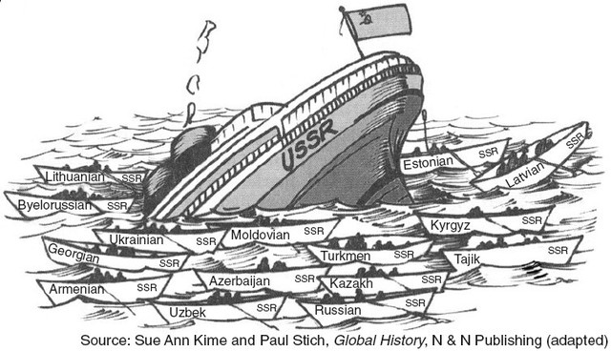
The Fall of the Soviet Union
By: Grayson Whelen
The Soviet Union officially ended on December 25th, 1991
Causes: A collapsing economy, failed economic reforms, increase in freedom of speech, and nationalist causes were all contributing factors to the collapse of the Soviet Union.
When Mikhail Gorbachev rose to power in 1985 the Soviet Union was already in a long state of decline. Gorbachev instituted economic reforms(perestroika) which failed and allowed greater freedom of speech(glasnost). Nationalist movements sparked in the baltics and other outer republics, weakening the central government. Finally, a coup was organized in which devoted communists hoped to end the protests with military action. The military refused to take action and the protests worsened. Gorbachev resigned on December 25th and the Soviet Union came to an end.
Outcome: The end of the Soviet Union brought the end of the Cold War that lasted since the end of WWII. Democracy spread and capitalism spread throughout a greater part of the world. New republics were established that had serious economic hardships to face. China changed economic stance. Many countries that were formerly supported by USSR struggled.
The collapse of the Soviet Union brought the end of the Cold War and the Warsaw Pact. It was also a major victory for Capitalism.

